Slide 1

Eco-Resilient Networks Smart Deployment for the Future
Muhammad Hamza Shahab
Syed Haider Abbas Naqvi
9th February 2025
Researching and Engineering Community Centred Software

Slide 2
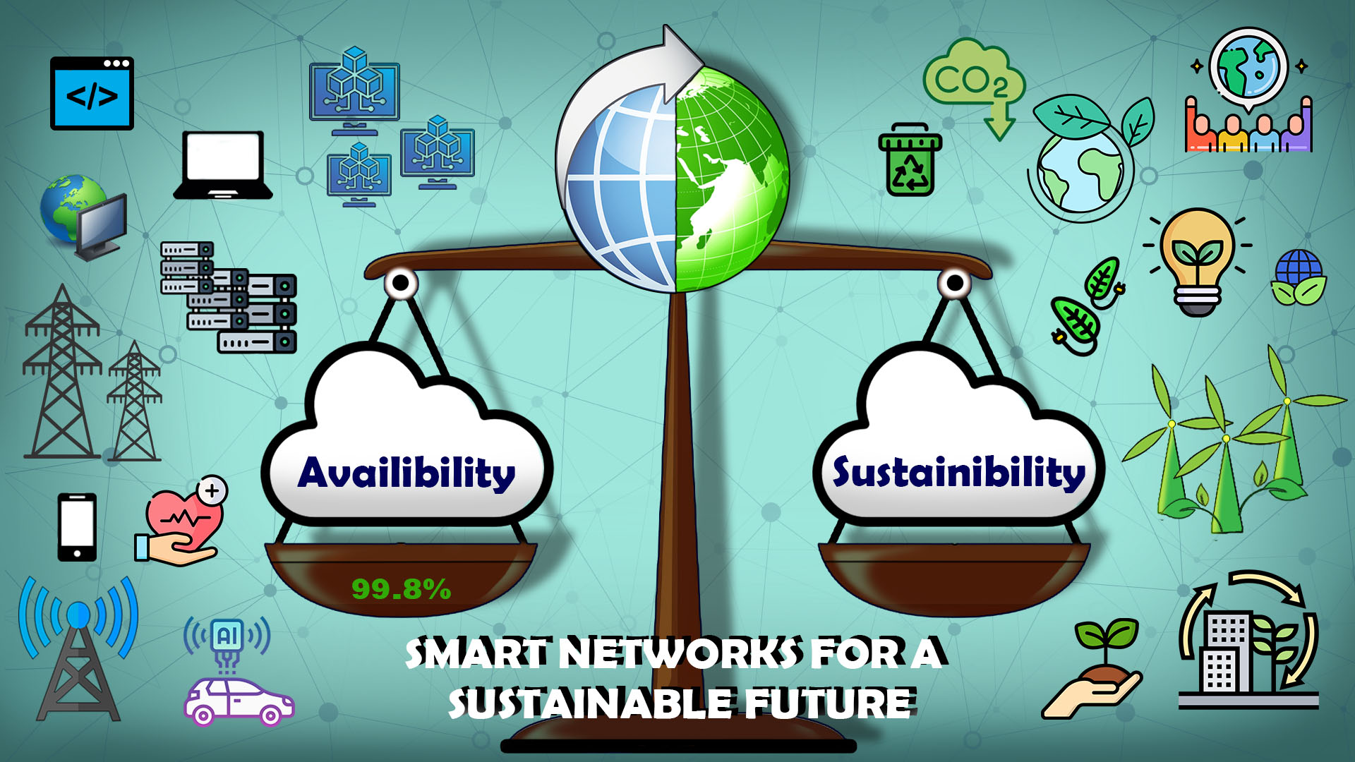

Slide 3




Our Motivation: Sustainable Development Goals

Slide 4
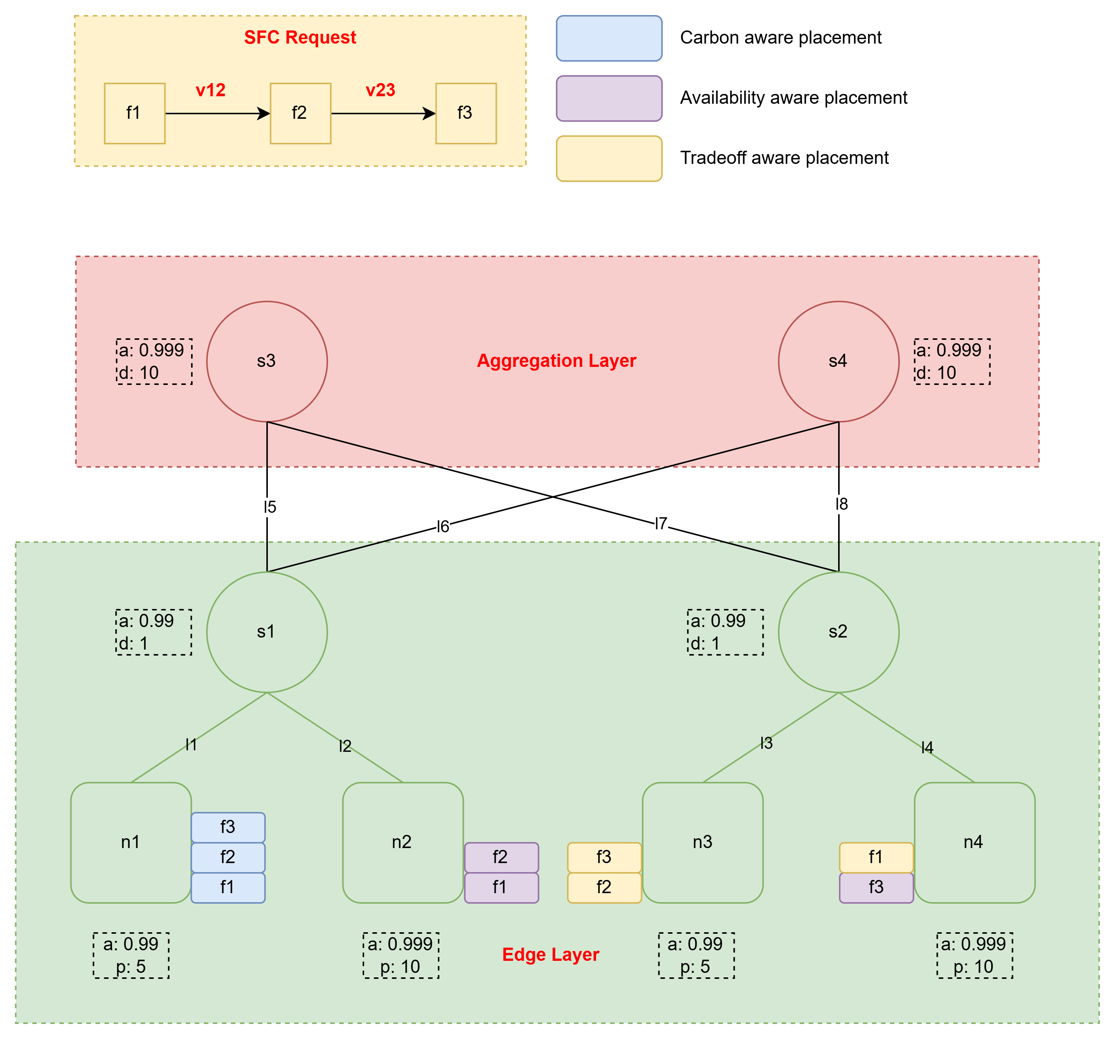
Optimizing Networks Allocation and Placement

Slide 5




Current State & Gap
Reactive, focused on uptime, often overlooks energy consumption.
Proactive, jointly optimizes availability and sustainability, data-driven decisions

Slide 6
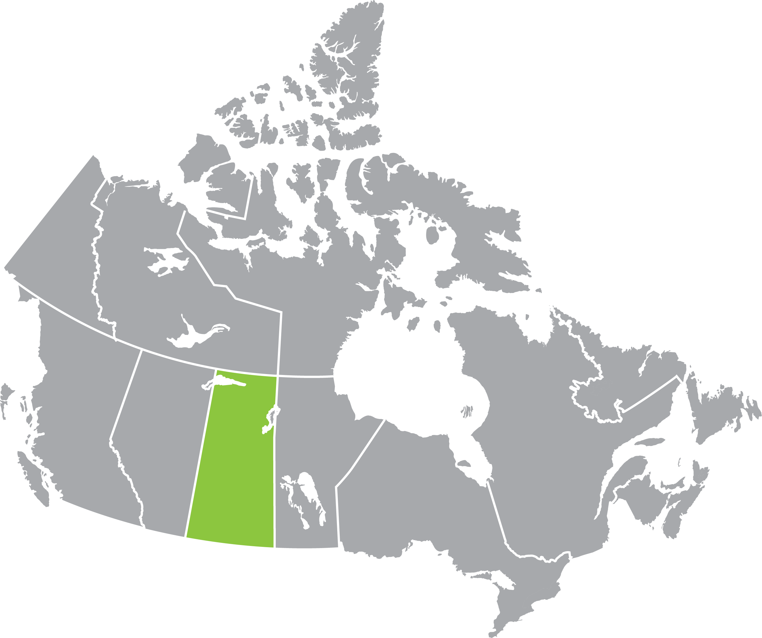

Slide 7


Slide 8




Community & Stakeholders

Slide 9

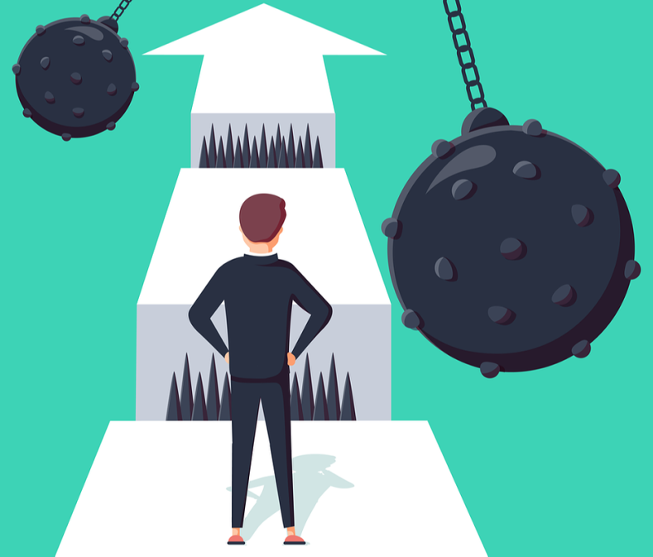

Challenges & Constraints

Slide 10
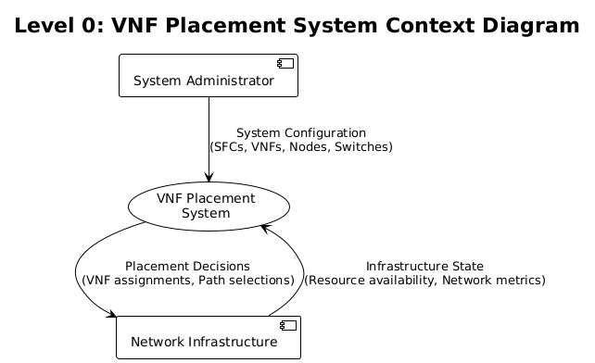
Architecture & Prototype

Slide 11
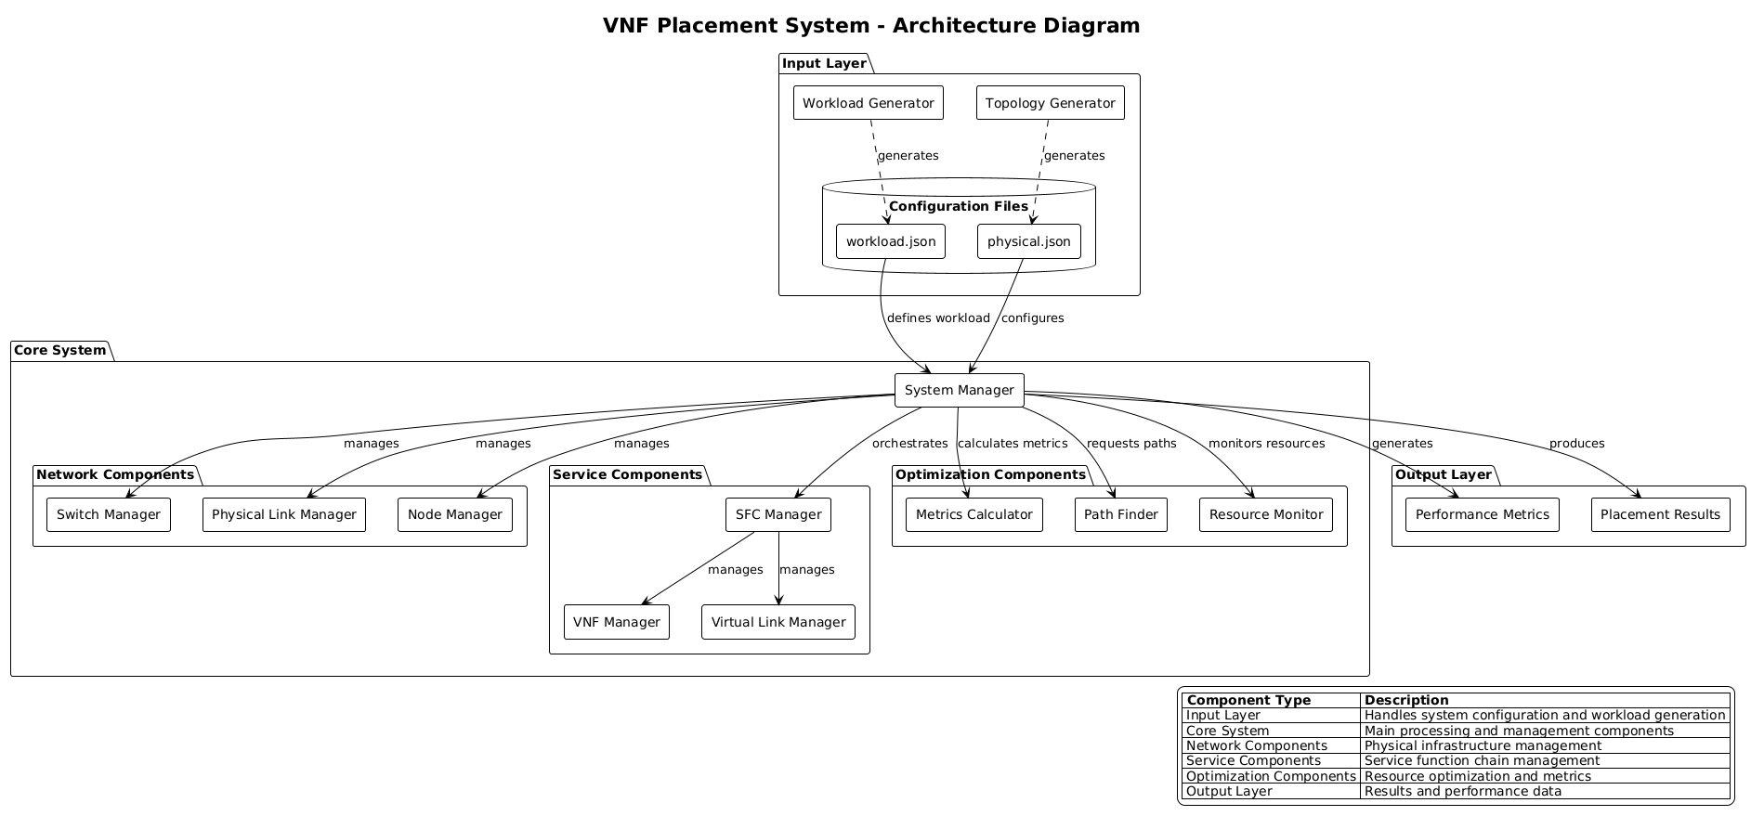

Slide 12
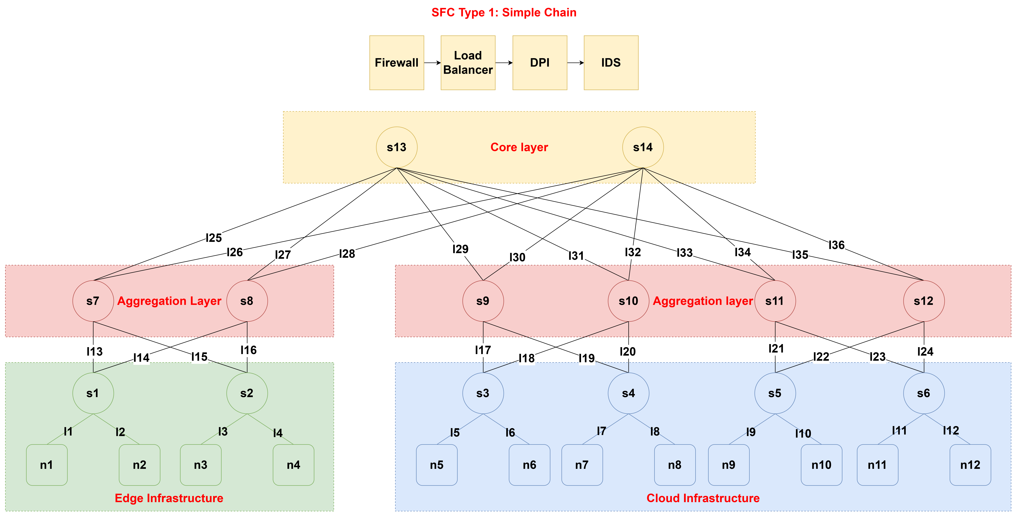

Slide 13

Thank You - Let’s Build Sustainable Networks!
Project Link: https://github.com/hamzashahab1610/ENSE-805-Project-Eco-Resilient-Networks.git
Contact:
Email: msx044@uregina.ca
LinkedIn: https://www.linkedin.com/in/hamzashahab1610/
GitHub: https://github.com/hamzashahab1610

